Slide 1

Machine Learning
Speech Emotions Classification
Present to:
Prof. Dr. Matthew N. Dailey
Dr. Alisa Kunapinan
Presented By:
Nguyen Thai Anh st122910
Nguyen Hong Duc st122934

Slide 2
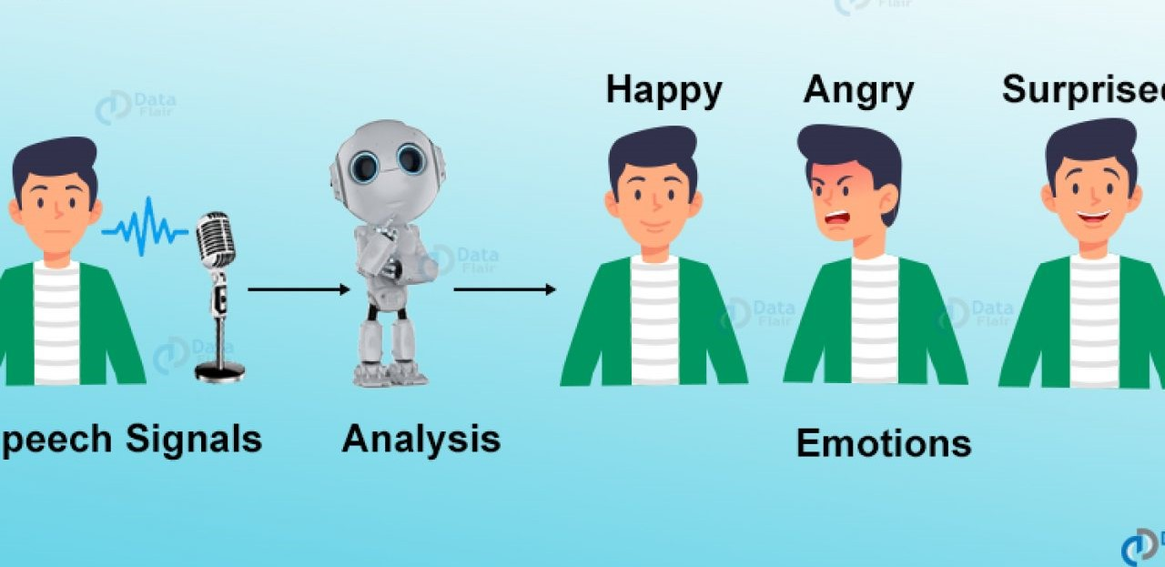
Introduction
Human speech is one of the most natural ways to express yourself.
Through words, we can easily know how they feel.
So, emotion detection is important in communication.

Slide 3
Objective
To apply our data scientist skill in other kind of dataset, especially audio dataset.
To classify different emotions such as angry, happy, etc… through voices using AWGN - Additive White Gaussian Noise with DL method. In our case, we focus on CNNs and Transformer-Encoder.
Compare and find which model will bring higher efficiency.

Slide 4
Data Review
Dataset link: https://www.kaggle.com/uwrfkaggler/ravdess-emotional-speech-audio
Brief Description: 2452 audio files, with 12 male speakers and 12 Female speakers with 8 different emotions by all speakers. Eight different emotions at two intensity levels (Strong and Normal): Calm, Happy, Sad, Angry, Fearful, Disgust, and Surprise, along with a baseline of Neutral for each actor.

Slide 5
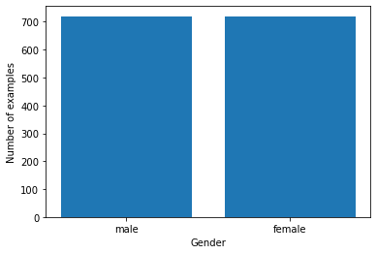
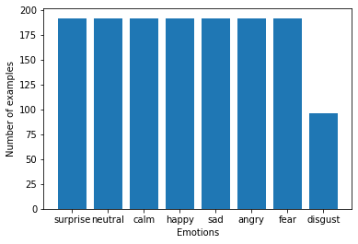
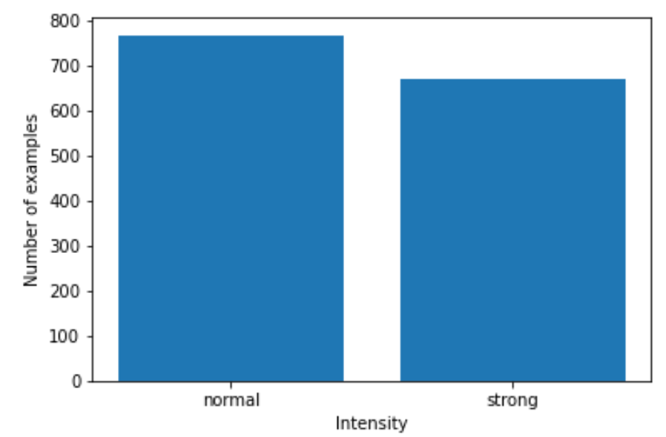
Check data balance

Slide 6
Preprocessing step
Define and load data.
Splitting into train/valid/test set.
Extract features(waveforms) for each set.
Augmenting and computing the Data with AWGN - Additive White Gaussian Noise.
Transform data into Tensor 4D arrays.
Feature scaling.

Slide 7
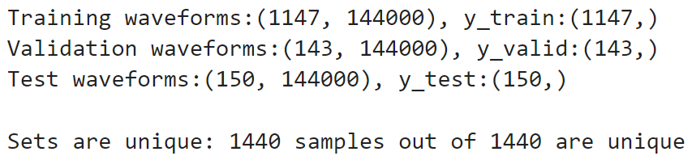
Train valid test splitting
In total, we have 1440 raw samples.
Apply a ratio of 80/10/10 train/validation/test split.
After splitting:

Slide 8
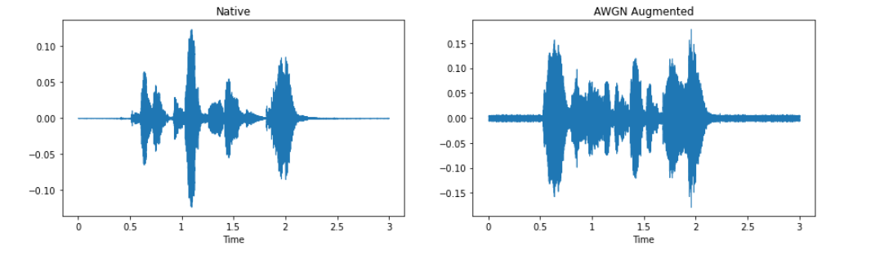
Augmented Waveforms

Slide 9
Modeling

Slide 10
Parameters
Loss function Cross Entropy Loss
Optimizer SGD
Learning rate 0.01
Epochs = 400
Notes:
Rambo

Slide 11
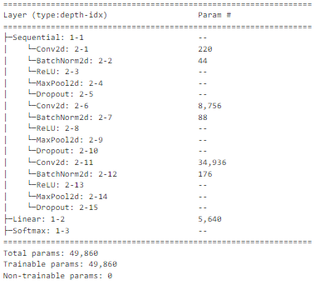
Modeling: Only CNN

Slide 12
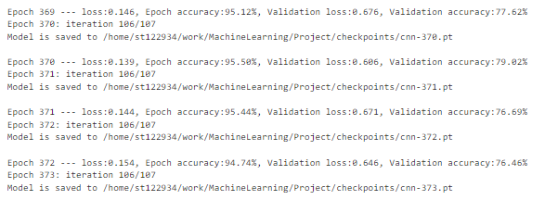
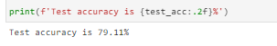
Modeling: Only CNN

Slide 13
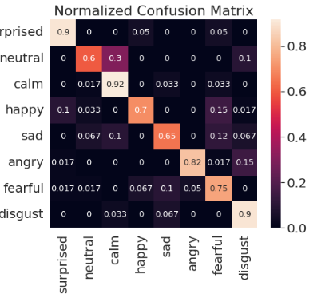
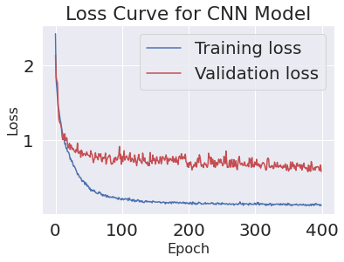
Modeling: Only CNN

Slide 14
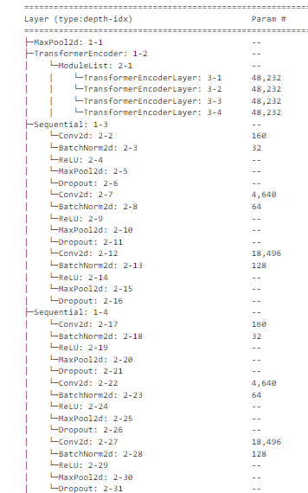
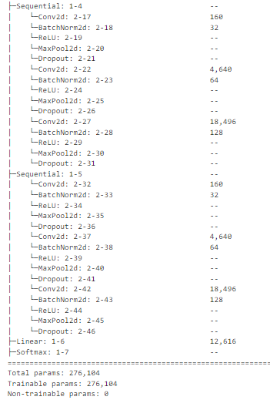
Modeling: 3 Blocks Conv parallel with transformer layer

Slide 15
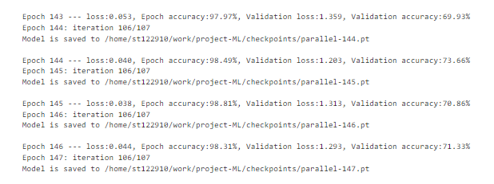
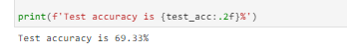
Modeling: 3 Blocks Conv parallel with transformer layer

Slide 16
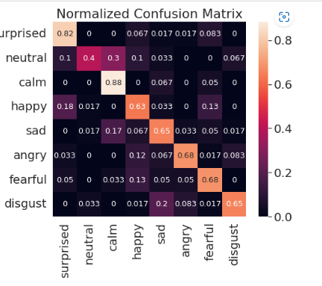
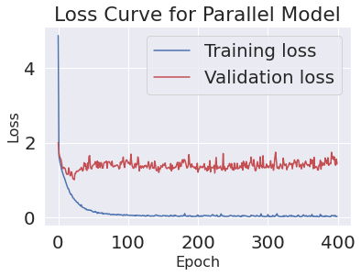
Modeling: 3 Blocks Conv parallel with transformer layer

Slide 17
Conclusion

Slide 18
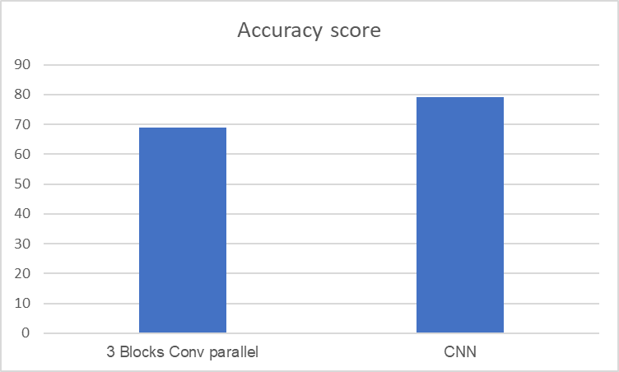
Accuracy score between models

Slide 19
THANK YOU

